Slide 1
12-factor apps in .NET
Building apps for the cloud

Slide 2
Who are you?
Software Developer for 20 years
Worked mainly for ISVs
Reuters, SunGard, Misys, Huddle
Worked for a couple of MIS departments
DTI, Beazley
Microsoft MVP for C#
Interested in OO, SOA, EDA,, Messaging, REST
Interested in Agile methodologies and practices
No smart guys
Just the guys in this room

Slide 3
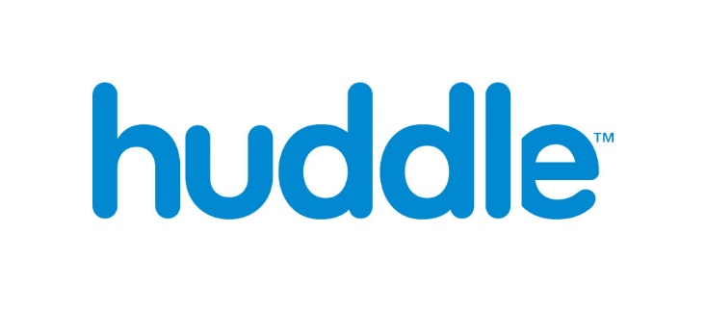
Intelligent collaboration for the Enterprise

Slide 4
Agenda
Context
Origins
Goals
The 12 Factors
Design
Build and Release
Manage

Slide 5
Housekeeping
Raise your hand if you can’t read the codes of the slides
For simplicity, you can download the slides from
https://github.com/iancooper/Presentations
And you can download the code from
https://github.com/iancooper/12FactorTutorial
Which should help from the back of the room.

Slide 6
Context
Why should you care?

Slide 7
12-Factor Apps are one of the pillars of Cloud Native

Slide 8
What is Cloud Native?

Slide 9
Perhaps we first need to ask: what do we mean by cloud?

Slide 10
“By cloud, we mean any computing environment in which computing, networking, and storage resources can be provisioned and released elastically in an on-demand, self-service manner.”
Migrating to Cloud-Native Application Architectures, Matt Stine

Slide 11
By Cloud Native we mean:

Slide 12
1. An application that has been designed to run in such an environment

Slide 13
2. An application that allows such an environment to be exploited.

Slide 14

Cloud Native Maturity Model
1. Cloud Ready | No permanent disk access Self-contained application Platform managed ports and networking
2. Cloud Friendly | 12 Factor App Methodology Horizontally scalable Leverages platform for high availability
3. Cloud Resilient | Fault Tolerant and resilient design Cloud-agnostic runtime implementation Bundled metrics and monitoring Proactive failure testing
4. Cloud Native | Microservices Architecture API-first design
Faiz Parker, Pivotal
Notes:
## Cloud Native Maturity Model
(Pivotal - )
1. Cloud Ready
* No permanent disk access
* Self-contained application
* Platform managed ports and networking
2. Cloud Friendly
* 12 Factor App Methodology
* Horizontally scalable
* Leverages platform for high availability
3. Cloud Resilient
* Fault Tolerant and resilient design
* Cloud-agnostic runtime implementation
* Bundled metrics and monitoring
* Proactive failure testing
4. Cloud Native
* Microservices Architecture
* API-first design
#

Slide 15
Increasingly we are seeing the guidelines applied not just to applications that run in the cloud but also those that run in containers
Containers run ’sandboxed executables’ with the intent of maximizing utilization of resources to lower costs
Using tools like Swarm, Kubernetes, ACS etc. containers can be scheduled in an on demand, self-service manner
So what is good for cloud in 12-Factor, is good for containers

Slide 17
Origins
Credit where it is due

Slide 18
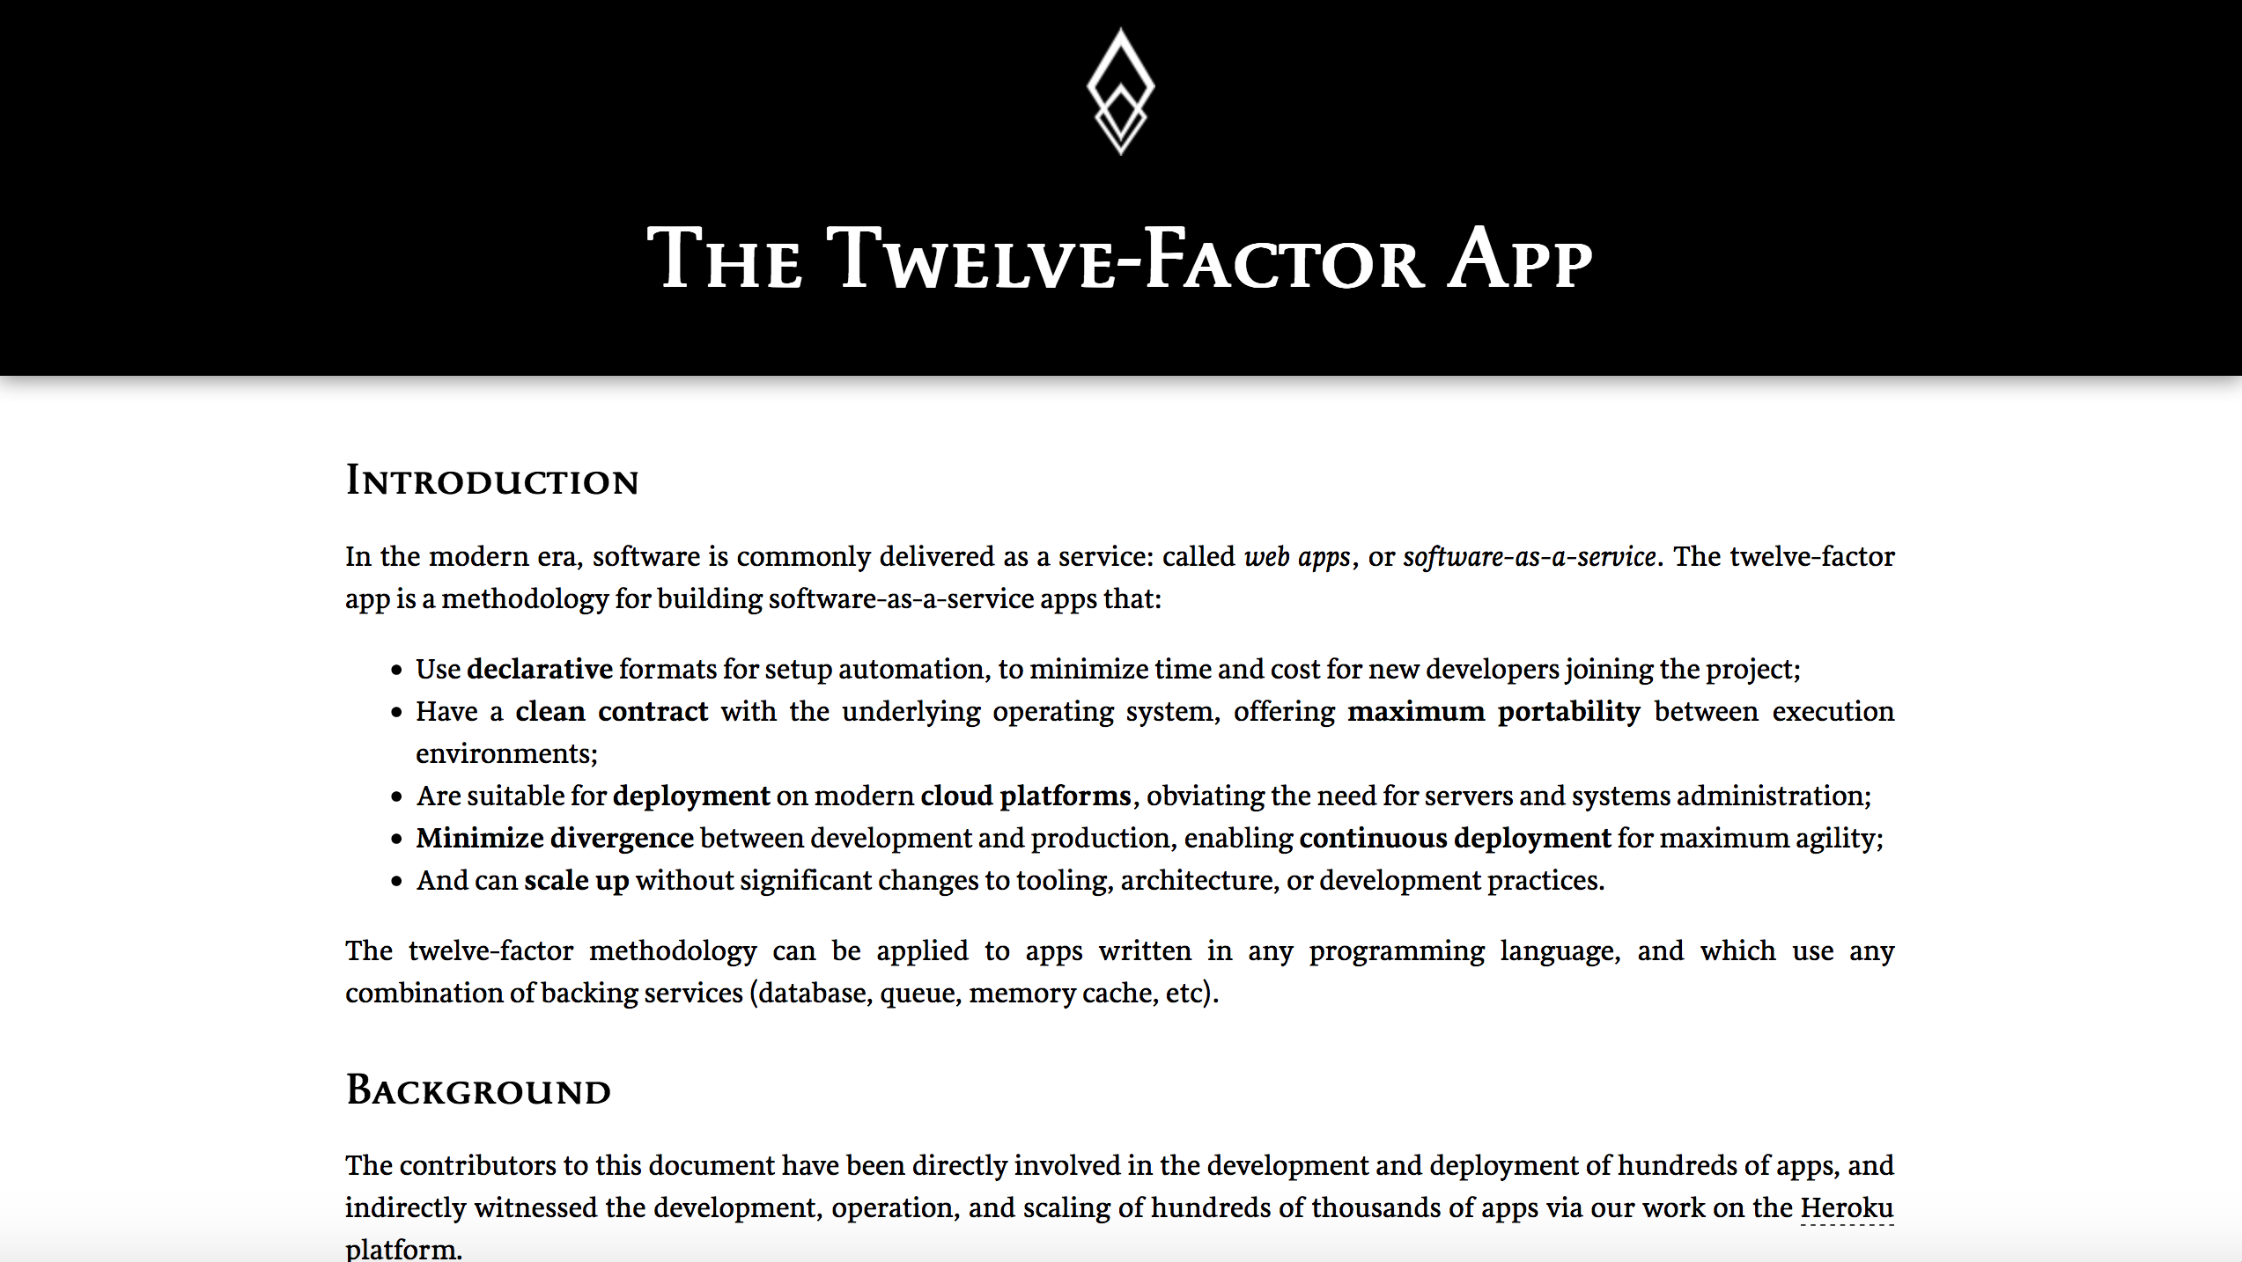
The Twelve Factor App
Created by contributors to the Heroku platform (particularly the co-founder Adam Wiggins):
Heroku is a Polyglot PAAS platform
The team derived the guidelines from their experience of what made app successful on Heroku.

Slide 19
The 12 Factors
The factors that impact how we design applications for the cloud

Slide 20
One codebase tracked in revision control, many deploys
Explicitly declare and isolate dependencies
Store config in the environment
Treat backing services as attached resources
Strictly separate build and run stages
Execute the app as one or more stateless processes
Export services via port binding
Scale out via the process model
Maximize robustness with fast startup and graceful shutdown
Keep development, staging, and production as similar as possible
Treat logs as event streams
Run admin/management tasks as one-off processes

Slide 21
Design
The factors that impact how we design applications for the cloud

Slide 22
Port Binding

Slide 23
“Export services via port binding”
Your app should bind to a port, and receive requests via that port, or return responses
The App should be self-hosted
It should spin up, and start listening on a port, or start talking to one
Apps talk to one another by exposing an address
A web app tends to listen to HTTP, but a backing service might listen to AMQP where the ’port’ is a URL to the server, etc.
Avoid hosting in an application server, like IIS
Notes:
There is a problem with hosting in IIS when we think about modern elastic scenarios.
I want to be able to spin up a reverse proxy and have that route traffic to two or more apps for HA and scaling needs. The apps themselves don’t need to provide a lot of the functionality of a web server i.e. serving static files, https negotiation etc. They just need to expose a port so that requests can be routed to them. I can do this easily with something like Nginx or HAProxy talking to an app that exposes a port, using separate instances to deploy to.
This all becomes a little harder with an application container like IIS, as each app would have to be deployed into an IIS web farm, with many apps deployed into the same container, separated by ports and using DNS for resolution. This doesn’t play well with PAAS scenarios or container scenarios as in the former case the provider should be doing this work for us, and in the latter case we want isolation of an app per container

Slide 24
https://docs.microsoft.com/en-us/iis/get-started/introduction-to-iis/introduction-to-iis-architecture
Notes:
When a client browser initiates an HTTP request for a resource on the Web server, HTTP.sys intercepts the request.
HTTP.sys contacts WAS to obtain information from the configuration store.
WAS requests configuration information from the configuration store, applicationHost.config.
The WWW Service receives configuration information, such as application pool and site configuration.
The WWW Service uses the configuration information to configure HTTP.sys.
WAS starts a worker process for the application pool to which the request was made.
The worker process processes the request and returns a response to HTTP.sys. The client receives a response.

Slide 25
Docker Registry
Image
Docker Host
Image
Image
Container
Container
Container
Container
Docker Daemon
Docker Client
docker run
docker exec
ocker ps
Dockerfile

Slide 26
“Treat backing services as attached resources”
Your ‘backing services’ are all the components and services your app needs to talk to
A database to store data
A message queue to communicate over etc.
But also your file system
And the cache
In cloud, containers, or serverless environments your host is ephemeral.
You cannot rely on its existence across requests
Always assume that you need to ‘provision’ any storage that you want to use
Notes:
There is a problem with hosting in IIS when we think about modern elastic scenarios.
I want to be able to spin up a reverse proxy and have that route traffic to two or more apps for HA and scaling needs. The apps themselves don’t need to provide a lot of the functionality of a web server i.e. serving static files, https negotiation etc. They just need to expose a port so that requests can be routed to them. I can do this easily with something like Nginx or HAProxy talking to an app that exposes a port, using separate instances to deploy to.
This all becomes a little harder with an application container like IIS, as each app would have to be deployed into an IIS web farm, with many apps deployed into the same container, separated by ports and using DNS for resolution. This doesn’t play well with PAAS scenarios or container scenarios as in the former case the provider should be doing this work for us, and in the latter case we want isolation of an app per container

Slide 27
First Demo: A vanilla ASP.NET Core App. Self-Hosted, it listens on a port
Notes:
-- Demo
Run the containers using docker-compose
Show hitting the website
--Walkthrough
Navigate to the startup and show we use kestrel to self-host

Slide 28
Demo

Slide 29
Processes and Concurrency

Slide 30
“Execute the app as one or more stateless processes”
The first key idea here is that your app should be stateless
No sticky sessions, store user’s state in your backing store
Reload your state if required to service subsequent requests
The memory space or filesystem of the process can be used as a brief, single-transaction cache.
Notes:
Sticky sessions hammer your ability to scale. Simply put you can’t move traffic between servers in your web farm. This causes two problems:
If the server the user’s request goes to comes under load (perhaps a noisy neighbor) you cannot move subsequent requests to a more performant server
If you need to take down a server for maintenance purposes then you have to kill any users who were using that server.
“The memory space or filesystem of the process can be used as a brief, single-transaction cache.” What does this mean. It means that we should make no assumptions about the persistence of memory on a server or the filesystem of a server beyond the request-response lifecycle. Any subsequent request will have to load the item again as it may be a different process running on a different machine.

Slide 31
Task Queues
Use separate processes for different workloads
HTTP workloads via a web process; Long-running background tasks by a worker process
An application may experience peaks of demand that cause it to become overloaded and unable to respond.
It could be that part of the application itself becomes overwhelmed or one of its dependencies becomes overwhelmed.
A task queue offloads work from the process that must respond in a timely fashion i.e. for a webserver < 300 ms to one that can respond slower
Notes:
Context and Problem
An application may experience peaks of demand that cause it to become overloaded and unable to respond.
It could be that part of the application itself becomes overwhelmed – due to a lack of CPU or memory – or it could be that the application depends on a third-party service that can become overwhelmed.
For example, there is a limited number of connections in a database connection pool. Long-running queries can lead to a lack of available connections to service requests. These requests in turn back up and overwhelm a server’s thread pool. This can cause queueing of requests on the server. Eventually the server stops serving requests.
“Done well, middleware simultaneously integrates and decouples systems. It integrates them by passing data and events back and forth between the systems. It decouples them by letting the participating systems removing specific knowledge of and calls to the other systems. Since integration points are the number-one cause of instability, this looks like a good thing.”
“Any kind of synchronous call-and-response or request/reply method forces the calling system to stop what it’s doing and wait. In this model, the calling system and the receiving system must both be active at the same time—they are synchronous in time—though they may be in different places. This category covers remote procedure calls (RPC), HTTP, XML-RPC, RMI, CORBA,
DCOM, and any other analog of local method calls. Tightly coupled middleware amplifies shocks to the system. Synchronous calls are particularly vicious amplifiers that facilitate cascading failures.”

Slide 32
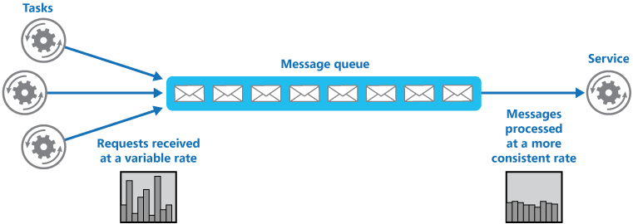
https://docs.microsoft.com/en-us/azure/architecture/patterns/queue-based-load-leveling

Slide 33
A producer puts a message onto a queue at the service endpoint. A consumer reads messages from the queue.
The queue stores messages for eventual processing. If the queue is durable we gain guaranteed delivery, and at-least once guarantees.
If the rate of arrival at the endpoint is unpredictable, the queue acts as a buffer that makes it possible to predict the rate of consumption.
This makes it simpler to do capacity planning because peaks of requests are smoothed out by the queue.
The consumer must be able to control the rate of processing, otherwise a spike is simply passed down the wire.
Notes:
As illustrated in figure 3.3, the Decoupled Invocation pattern is composed of three basic components: a handler, a queue, and a dispatcher that mediates between them. Here’s how the initial request processing works:
The handler listens for incoming requests from the endpoint.
When a new request arrives, the handler sends an acknowledgment to the sender.
The handler is responsible for the initial treatment, or preprocessing, of incoming messages. This may include message transformation or prioritization based on knowledge it infers from the messages themselves. Overall, this processing should be kept minimal, as the goal is to quickly queue and acknowledge incoming requests.
The message is put onto a queue.
The queue, which is the second component of the Decoupled Invocation pattern, stores incoming messages and allows the service to consume the messages at its own steady rate, thus overcoming peak loads.
You can set up the queue to be persistent so the service won’t lose any requests it has already acknowledged, even if a catastrophic server failure occurs. If the queue is transactional, you can also implement the Transactional Service pattern (see chapter 2) and increase the overall robustness of the service even further.
The dispatcher is responsible for creating as many reader components as are needed for the current request load, which is measured by the number of messages waiting in the queue. The dispatcher can also prioritize incoming tasks based on internal considerations, such as resource availability. The dispatcher is a good place to introduce elasticity if the latency of handling the messages is important. (See also the further reading section for an article on the LMAX architecture, which describes a low-latency, high-performance queue between senders and receivers.)
The handler can acknowledge the request as part of the preprocessing, but it’s usually best to do this inside an edge component (see the Edge Component pattern in chapter 2). This helps ensure that the service-processing load is kept to a minimum, allowing the handler to process requests as efficiently as possible.
Placing requests on the queue is a relatively low-cost operation that can be performed efficiently, making the initial request-handling less susceptible to failure during peaks (as compared to other parts of the request-handling that require more time and resources). The actual handling of the incoming requests can be performed at a reasonable pace, dictated by service resource availability and overall load. Load balancing can be achieved by running multiple readers against the queue.

Slide 34
Second Demo: A Brighter Worker App, using Console, it listens to AMQP
Notes:
-- Demo
Run the containers using docker-compose
Show hitting the website
--Walkthrough
Navigate to the startup and show we use kestrel to self-host

Slide 35
Demo

Slide 36
“Scale out via the process model”
Prefer to scale out, using new instances of the process
As a process is ‘share-nothing’
We can introduce greater capacity by introducing new processes
Don’t demonize use the operating system’s process manager
Notes:
Nothing in the 12-factor app manifesto says you cannot vertically scale.
So it is permissible for a 12-factor app to multiplex via threads in the runtime (and indeed some runtimes are expensive to create so this model should be used), or to use asynchronous/evented reactor models to increase throughput when performing IO etc.
But vertical scaling becomes prohibitively expensive at a certain point and does not aid with availability
We don’t demonize because this implies access to low-level OS services which risks software erosion and may not be available on all platforms we deploy to. Instead we should rely on a process manager to provide our runtime management needs. (Note that this implies we should move away from Windows Service deployments as these demonize the console application and use Task Scheduler instead).

Slide 37
“Maximize robustness with fast startup and graceful shutdown”
A process should be able to start and stop at a moment’s notice
Start in a few seconds
Stop Gracefully
This is needed for elastic scaling, we have to be able to bring new resources online quickly to meet demand or shut them down when done.
Notes:
A quick start aids scheduling: we can bring capacity on stream rapidly when we need it. Monitor your startup times, use background workers if required to allow a responsive start to receive requests, and a queue for those requests to wait for resources to come on stream if they are expensive.
A graceful shutdown reassures administrators that they can safely terminate instances: the ideal would be:
Web process: finish any existing request, but refuse new requests. Assuming that a request can be completed in under 300ms or so, to allow shutdown to be fast
Worker process: either return work to the queue with a nack, or finish work before shutting down. The choice depends on how long work takes (fast jobs under 500ms could be allowed to finish), and the extent to which work is reentrant either by being transacted or idempotent so that it can be canceled and then re-run.
It is also important to consider what happens in the event of catastrophic failure i.e. hardware loss. The use of automatic rollback of transactions, messages to the queue, etc. after a timeout is helpful here as it prevents us failing in an ‘inconsistent’ state.

Slide 38
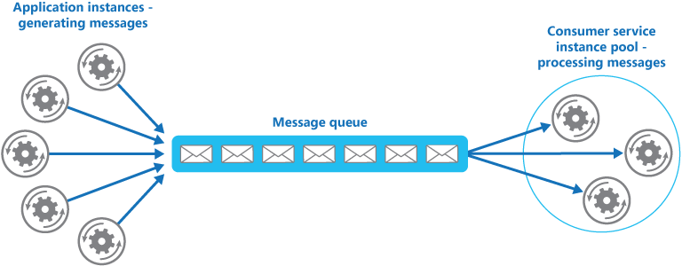
https://docs.microsoft.com/en-us/azure/architecture/patterns/competing-consumers

Slide 39
Third Demo: The Docker-Compose File for the App can be used to run multiple instances and load balance between them
Notes:
-- Demo
Run the containers using docker-compose
Show hitting the website
--Walkthrough
Navigate to the startup and show we use kestrel to self-host

Slide 40
Demo

Slide 41
Build & Release
The factors that impact how we deploy applications to the cloud

Slide 42
“One codebase tracked in revision control, many deploys”
The code repository or repo is a copy of the revision tracking control database
1 App == 1 repo
Multiple repos are a distributed system
Shared code must be managed via dependency manager, not shared source in repo
A deploy is a running instance of the app, using the same repo
Notes:
By one codebase per app, do we only mean codebase per process?
Take the example of a web and worker, that share the same model, but the worker uses the same domain model and Db and just handles the long-running workloads.
One or two repos? Some folks (Pivotal) say two because there is a smell that you may actually have two microservices.
The key issue is CI boundaries. Do you have one CI boundary i.e. build and test together? Then put it in the same repo (corollary with admin tools). This is a microservice boundary anyway i.e. a bounded context. Split the repo for separate microservices.
i.e. on app == one microservice == one repo

Slide 43
Demo Prep 1: Pulling the Code

Slide 44
Dependencies

Slide 45
“Explicitly declare and isolate dependencies”
Requires the ecosystem to support a package manager
Requires the ability to isolate an app from other apps i.e. no shared dependencies
Examples include a gemfile or a requirements.txt file produced by Pip
Isolation includes something like Python’s virtualenv
We want to install the runtime and package manager only
clone, restore, build, run
git clone, dotnet restore, dotnet build, dotnet run is a good example of this

Slide 46
Demo
Notes:
Open a new command prompt
Create a directory
Git clone https://github.com/Arc-Lightning/FutureStack repository
Review the Dockerfiles in Code
Point out that we grab a clean base image (use runtime only image, not SDK)
Point to the code where we restore the dependencies for the application
We may find that internet connection is poor and we don’t have dependencies
So you need to use the Dockerfile to ‘pre-bake’ an image with dependencies realized on the machine

Slide 47
“Store config in the environment”
In this case configuration means anything that varies between deploys
A 12-factor app requires strict separation between config and code.
Config is not checked into the app’s repository.
It often contains secrets such as passwords, or topology dependent information
Because configuration varies by environment – store it in environment variables
Routing tables etc. are not considered configuration for this.
They can often be set in code
But even if you use config, it is not config between enviroments
Notes:
The smells here are:
Per-environment configuration files checked into source control
Templated configuration files checked into repos that must be merged with per-environment data files
Environment information hard-coded into source code (obviously)
You could still have a configuration file, particularly if your runtime requires it, to tell you how to run the software, provided it is information that does not vary by deploy. Prefer code for many of these settings if possible, especially if you would be likely to re-deploy as a result of any change i.e. routing changes probably mean that you have written a new handler so you would redeploy anyway.
But things that change at runtime, such as connection strings, no-of-threads, timeout values, urls of external services etc. should be stored in environment variables.
Why not just use a file and merge?
Complexity. It’s simpler just to grab from the os. You want an immutable release artefact, not an artefact that must be rebuilt for every environment that it is deployed to. Avoid rebuilding for different environments, instead rely on an immutable release artefact that does not vary
In PASS environments we may not have access to configuration files
In Container environments its simple to use a .env file to provide the environment information

Slide 48
“Strictly separate build and run stages”
The build stage converts the repo into an executable unit: a build
It uses a commit to the repo and fetches dependencies to create an asset
A release is a combination of a build and the config for a given environment
The run stage executes the app in a given environment
All these stages should be separate.
For example, no changes to deployed code, you have to alter the repo and build again
Notes:
This is fairly common nowadays: gone is the bad old era when people would hop onto the production server and manually edit the running configuration. The issues are numerous but the issue of ‘lost changes’ during the next build is particularly pernicious here.
Note that the environment is factored in at release. Broadly to change the environment should not involve a new build – the artefact becomes immutable, but may require restarting the app in order to load those environment changes.

Slide 49
Demo
Notes:
Open the application in Code
Show where we have configuration, and it is pulled from environment variables
Show where we have routing etc. in code
Edit the docker-compose file in Code
Production and Development environment equivalency
Build is done by a flag, we can build and then run

Slide 50
Summary

Slide 51
Summary
One codebase tracked in revision control, many deploys
Explicitly declare and isolate dependencies
Store config in the environment
Treat backing services as attached resources
Strictly separate build and run stages
Execute the app as one or more stateless processes
Export services via port binding
Scale out via the process model
Maximize robustness with fast startup and graceful shutdown
Keep development, staging, and production as similar as possible
Treat logs as event streams
Run admin/management tasks as one-off processes

Slide 52
Q&A
Please share your feedback

